Slide 1
Welcome Assembly Year 5 and 6

Slide 2
Staffing
Mrs Holdsworth – Assistant Head and Key Stage Lead
Miss Danby – Y6 teacher (18)
Mrs Hills - Y6 teacher (17)
Mrs How – Y6 HLTA
Miss Collins – Y5/6 teacher (16)
Mrs McKibbin – Y5 teacher (15)
Miss Wildridge – Y5 teacher (14)
Mrs Burrell – Y5 Teaching Assistant

Slide 3
Expectations
Correct uniform
Correct PE kit
Completing homework
Having a water bottle in school
Arriving on time
Attendance

Slide 4
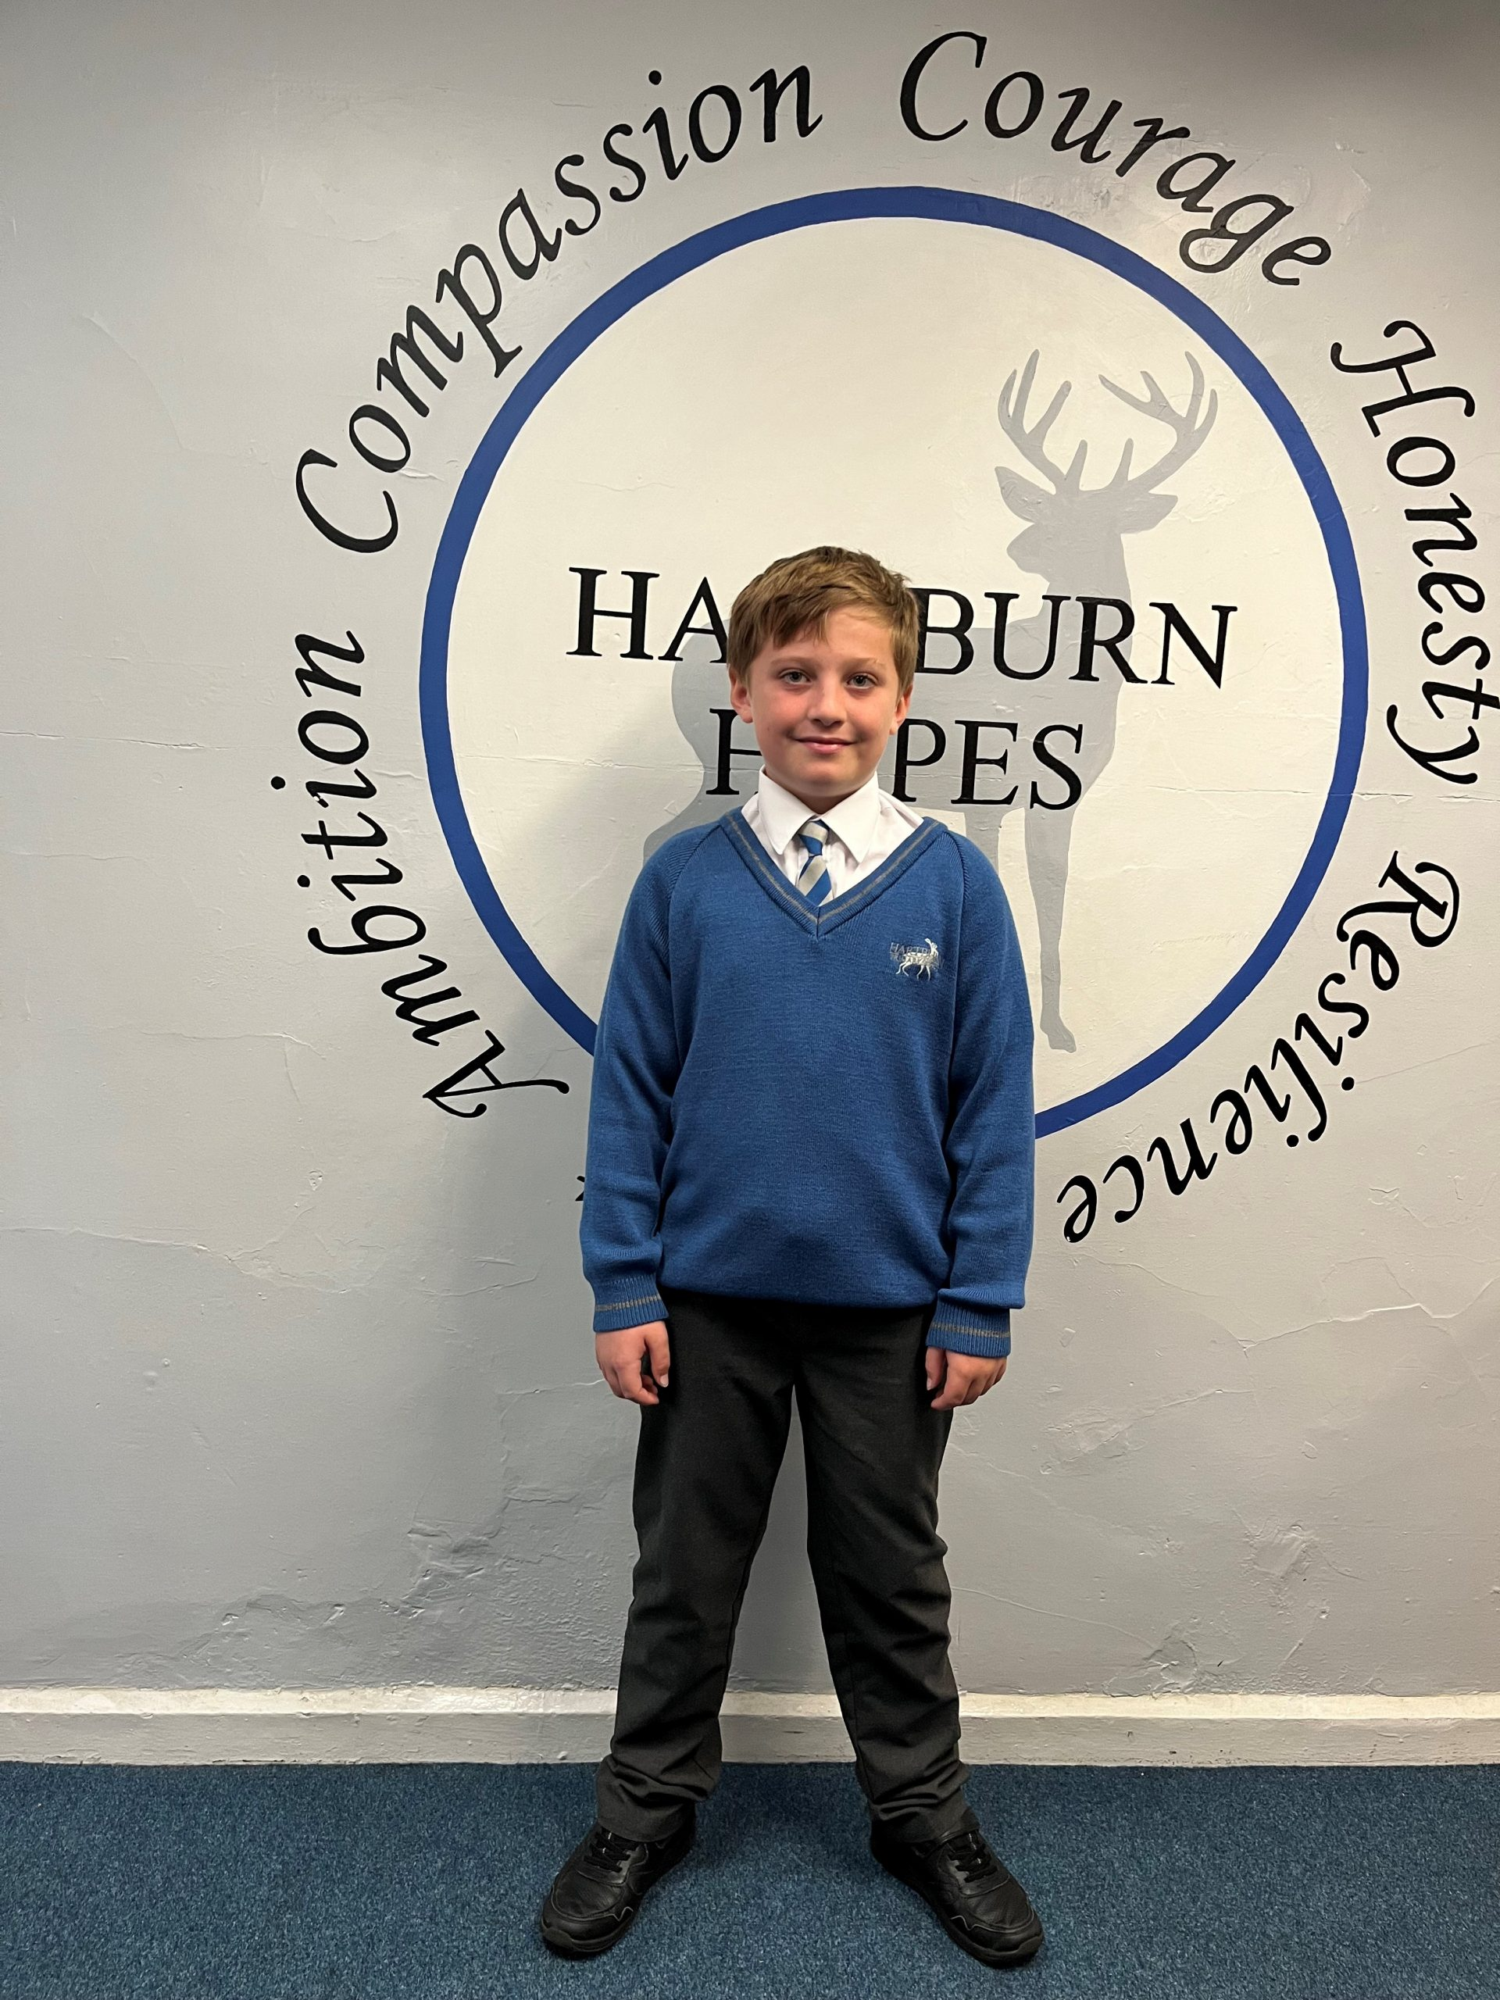
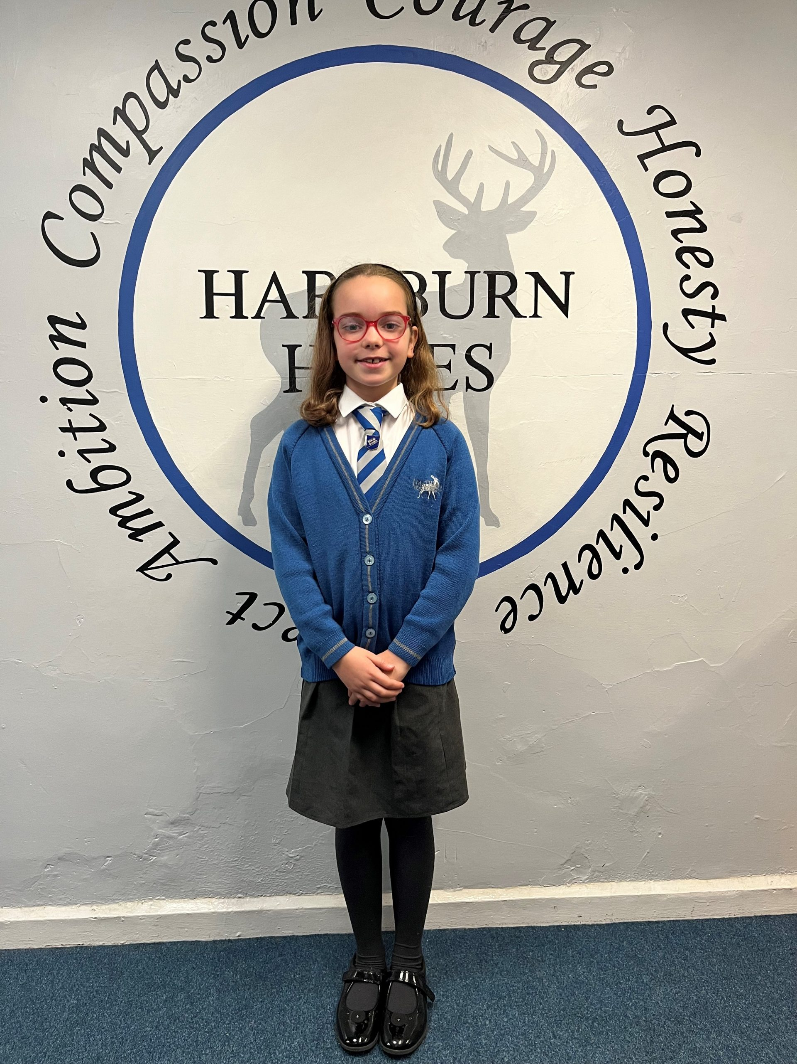
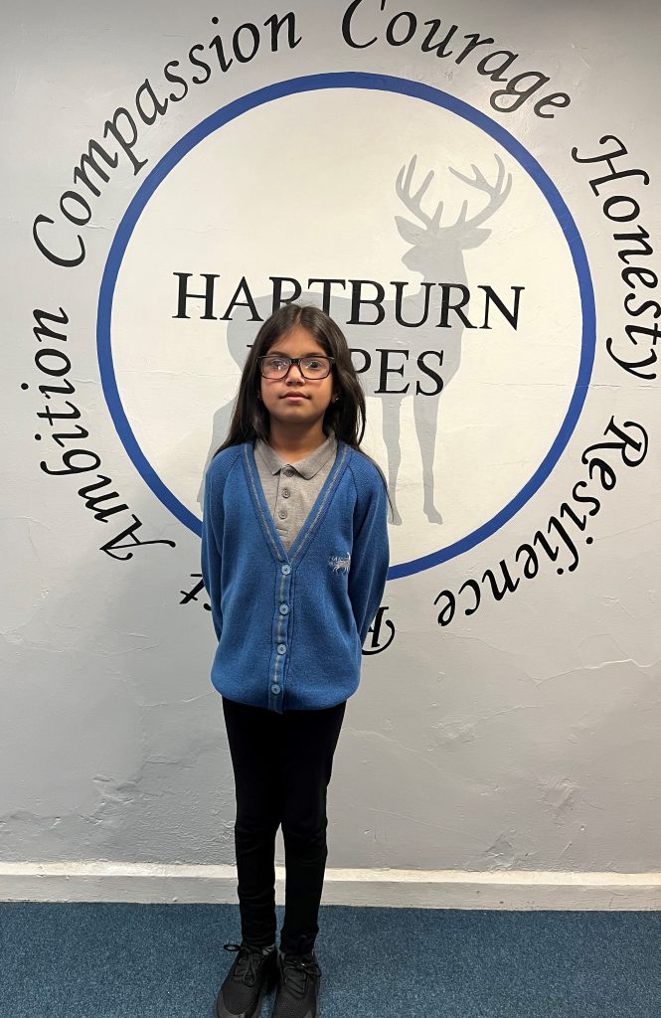
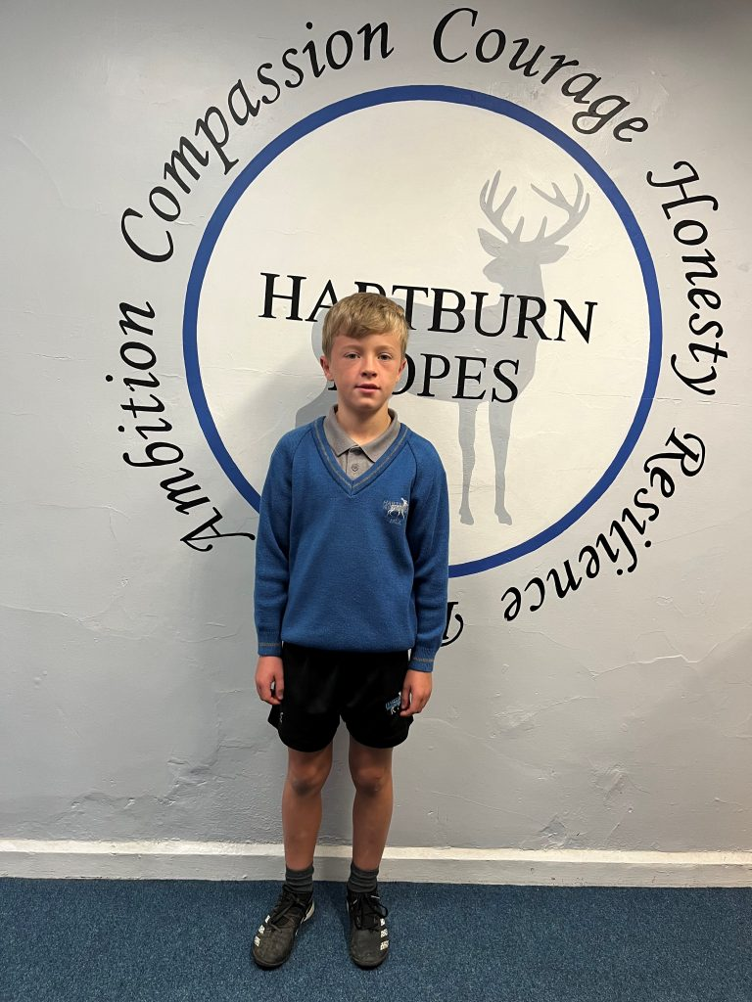
Uniform reminders
Jewellery for PE days
Heeled shoes
PE shorts
Make up – eyelashes, nails, tan
Coloured trainers

Slide 5
Reading
John Murray –class reading
Reading Plus
Reading at home
Reading for pleasure
Class story time

Slide 6
Maths
Curriculum
Structure of lessons
TT Rockstars
My Maths
Arithmetic tests
Problem solving

Slide 7
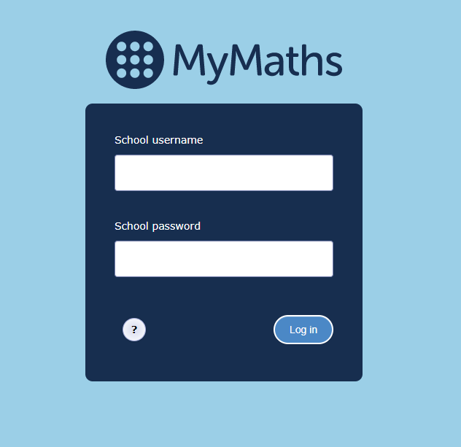
Homework
Reading Plus
SPAG.com (Y6 only)
Spelling shed (Y5 only)
TT Rockstars
My maths
Y6 homework booklets – SPaG, reading, maths

Slide 8
Writing
SPaG curriculum
Spellings and spelling shed
Genres of writing
Culture of choice
Links to topics

Slide 9
Curriculum – Autumn - Maafa

Slide 10
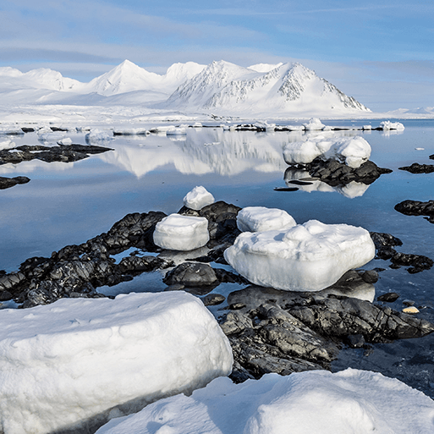
Curriculum – Spring – Frozen Kingdoms

Slide 11
Curriculum – Summer –Britain At War

Slide 12
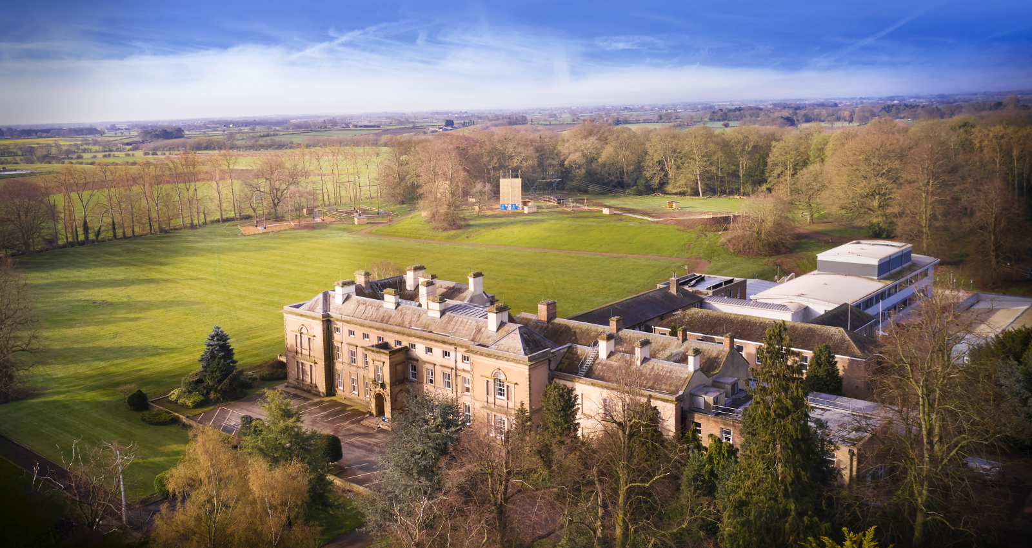
Further information
Y6 SATs - 12th – 15th May
Separate information will be sent closer to the time
Newby Wiske 2024 – 21st – 25th October 2024 - meeting on Monday
Newby Wiske 2025- will take place on 20th-24th October 2025 – letters for expressions of interest and a parent meeting will be held later this term.
Y6 booster groups start in the Spring term – invitation only

Slide 13
Communication
Curriculum newsletter
Hartburn Herald – every Friday
Facebook page
Website – calendar
Messages and letters sent electronically – check email addresses
UKS2 door every morning

Slide 14
Wrap Around care
Breakfast club from 7.30
After school club until 6pm
Contact the office for queries and bookings

Slide 15
FOHPS
A registered Charity
A group of Hartburn Primary School Parents
All of us have (or have had) children at the school
‘Our ethos is to provide continued support to the school to assist in providing every child with the opportunity to fulfil their full potential. We have funded a range of equipment such as PCs and Ipads as well as giving substantial donations to the school to assist in the renovation of the outdoor areas including the installation of a MUGA (multi use games area) and lighting for the school stage’

Slide 16
Thank you!

