Slide 1
Welcome to
Year 3

Slide 2
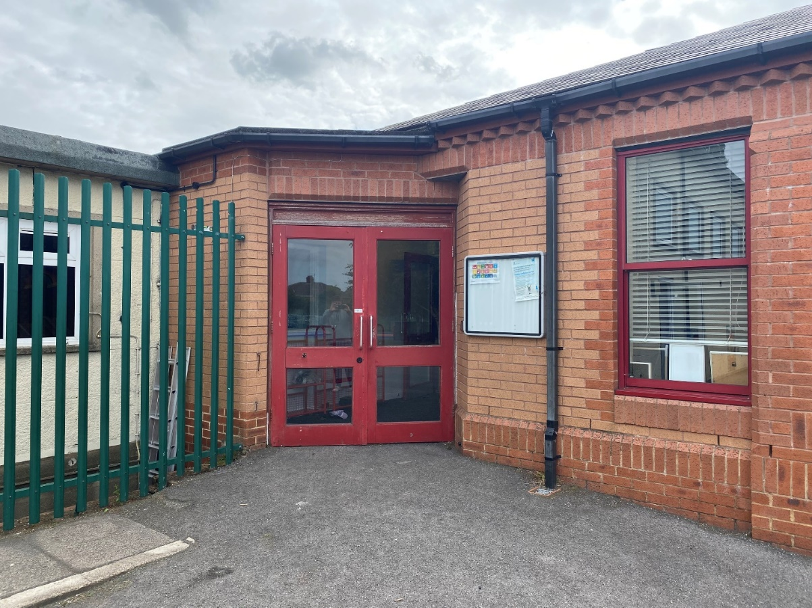
You will come in through this door.
Doors open at 8:45am and school starts a 9:00am.
It is really important that you are on time every morning!

Slide 3
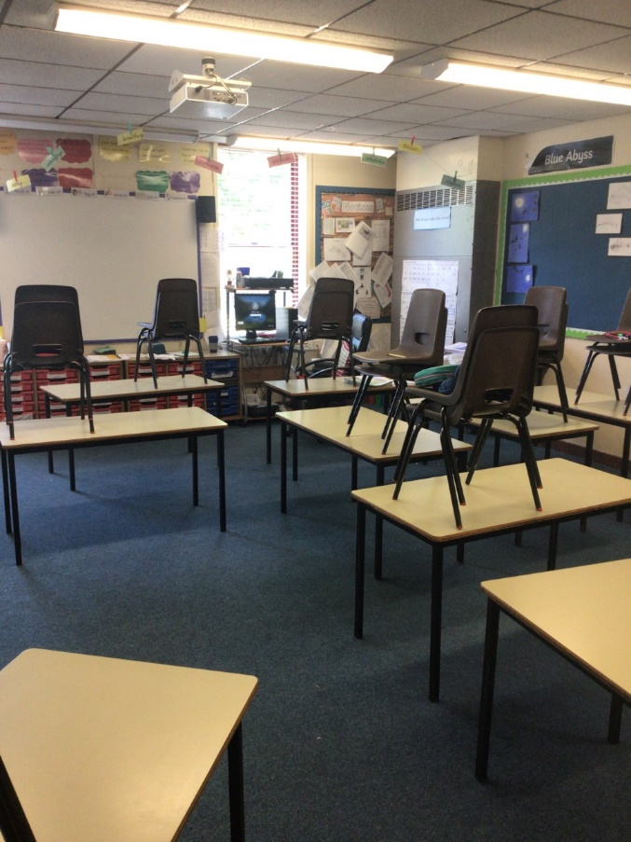
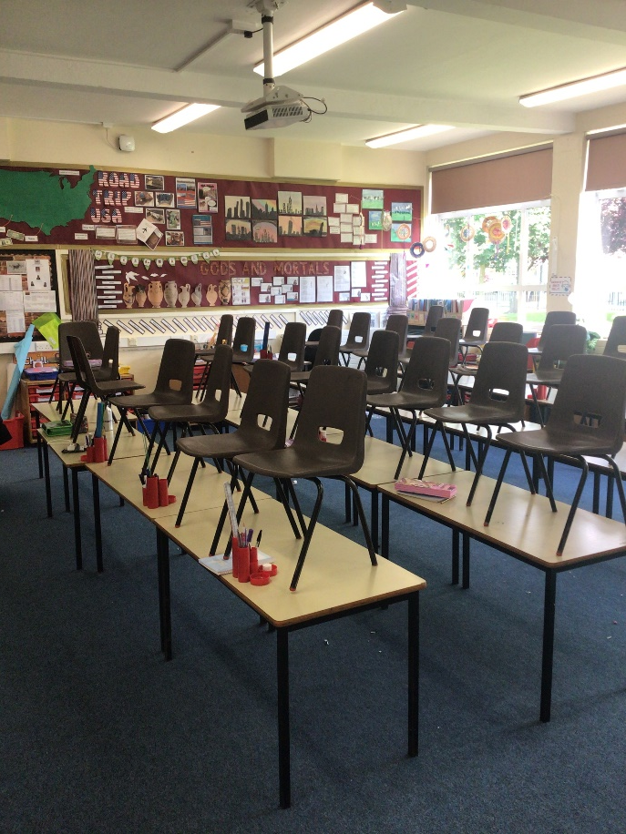
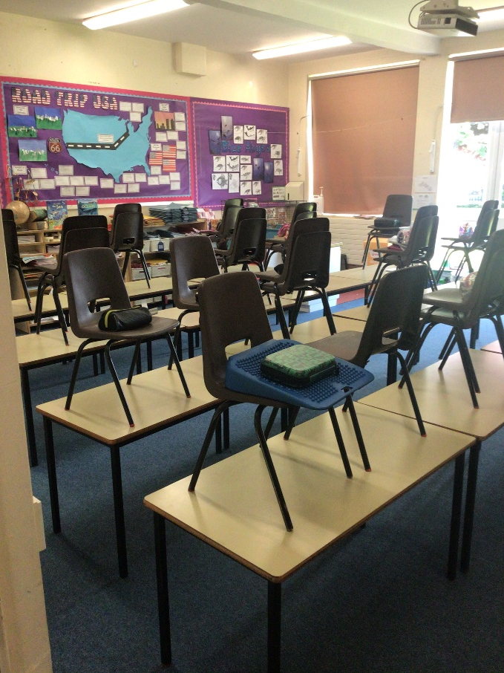
We have 3 classrooms in Year 3: Class 9, 10 and 11.
Class 9
Class 10
Class 11

Slide 4
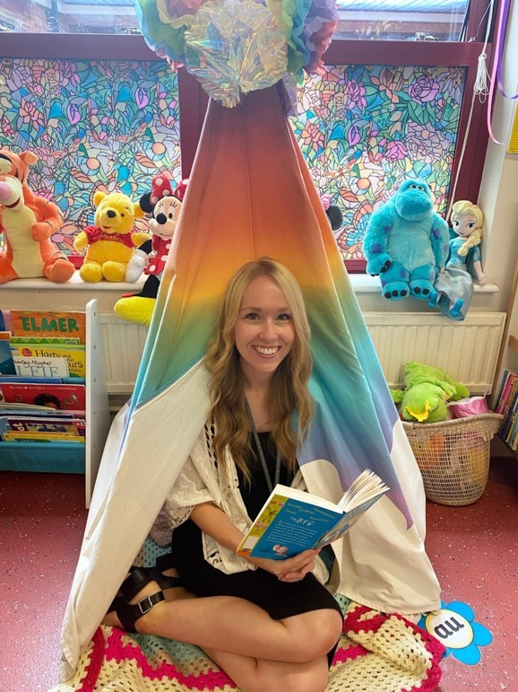
Class 9
Mrs Close
Mrs Whem

Slide 5
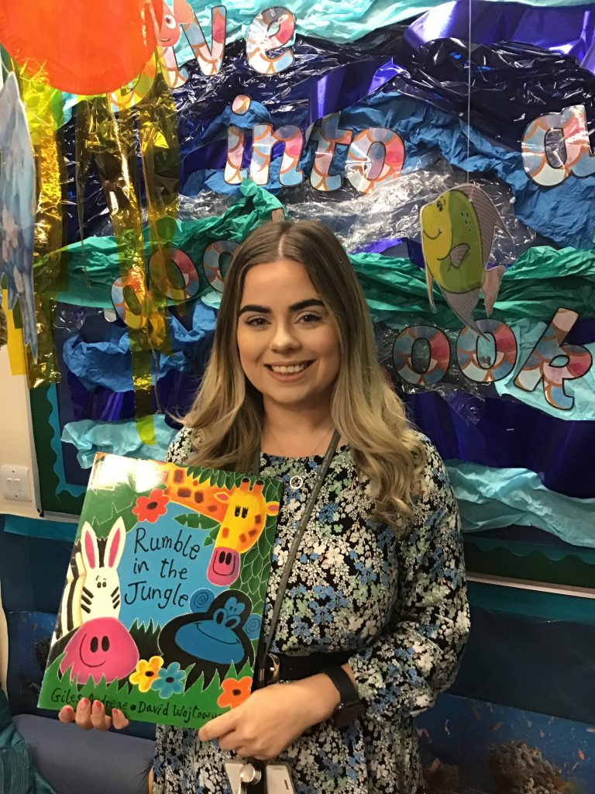
Class 10
Mrs Eddy

Slide 6
Class 11
Mrs Hughff

Slide 7
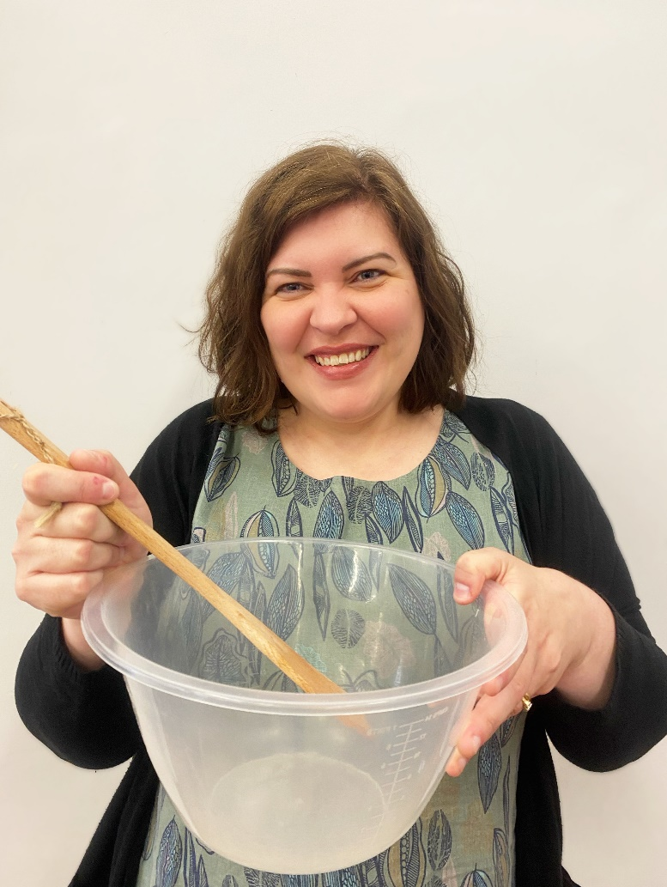
Some of you may also be taught by Mrs Goodwin.

Slide 8
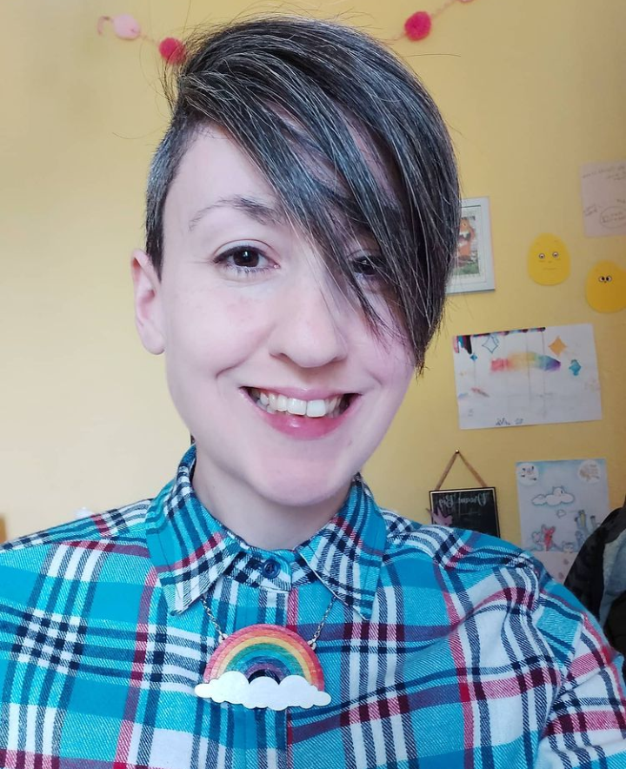
Our Fantastic Teaching Assistants
Mrs Marshall
Mrs Wicks

Slide 9
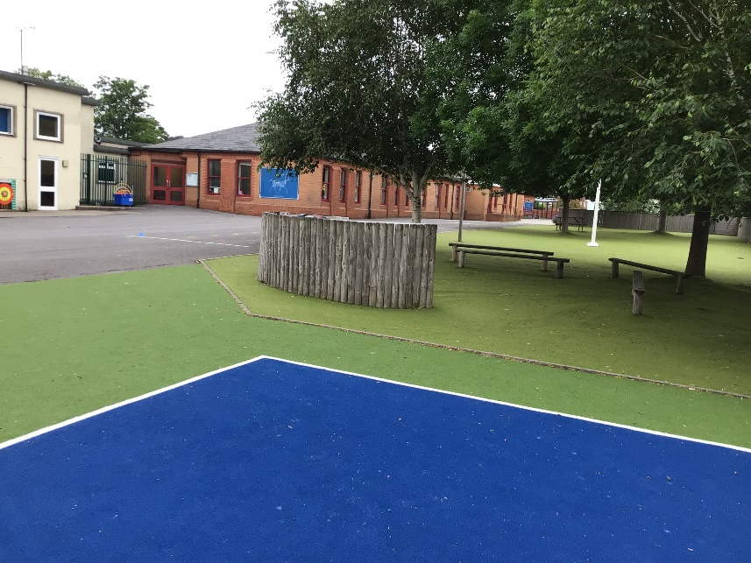
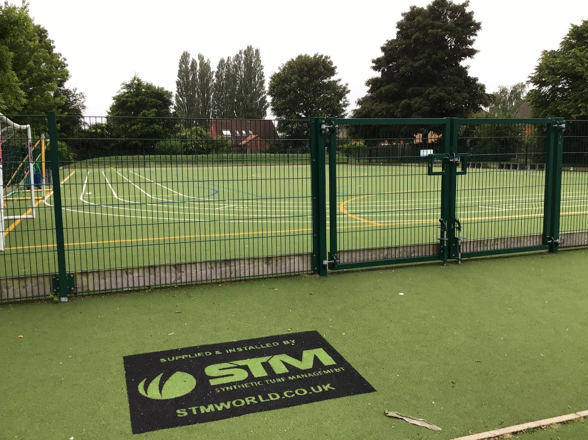
Outdoor Space.

Slide 10
You will eat your dinner here.

Slide 11
This is what your day will look like.
9:00 – Registration
9:15 – Reading
9:30 - English
10:45 – Break
11:00 – Maths
12:15 Lunch
13:15 – Afternoon lesson
14:30 – Afternoon lesson
15:15 - Home
Your timetable may differ sometimes to allow for other activities.

Slide 12
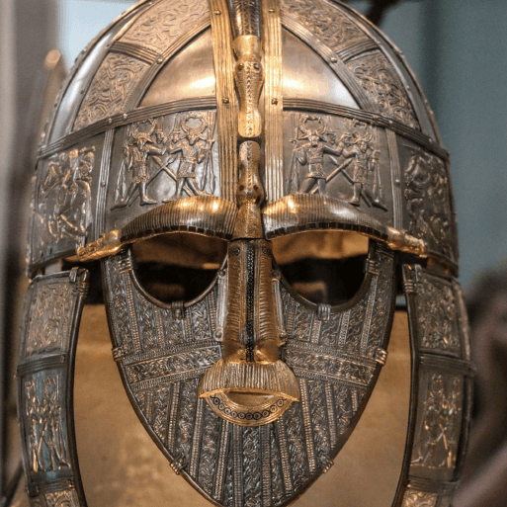
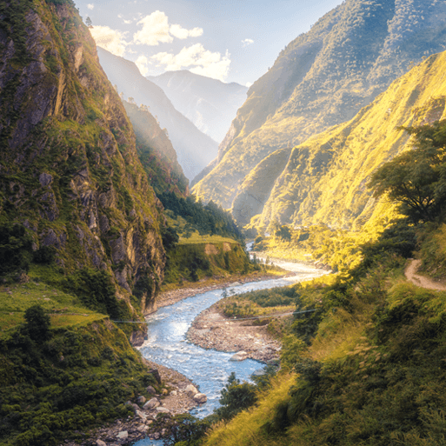
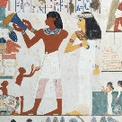
This is what you will be learning about.
Invasion
Misty Mountain, Winding River
Ancient Civilisations

Slide 13
You will leave through this door.
You will finish school at 3:15.

Slide 14
We cannot wait
to see you in September!
Have a lovely summer and stay safe.

