Slide 1
Welcome to
Year 1

Slide 2
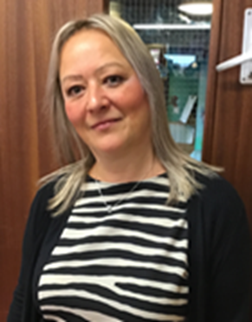
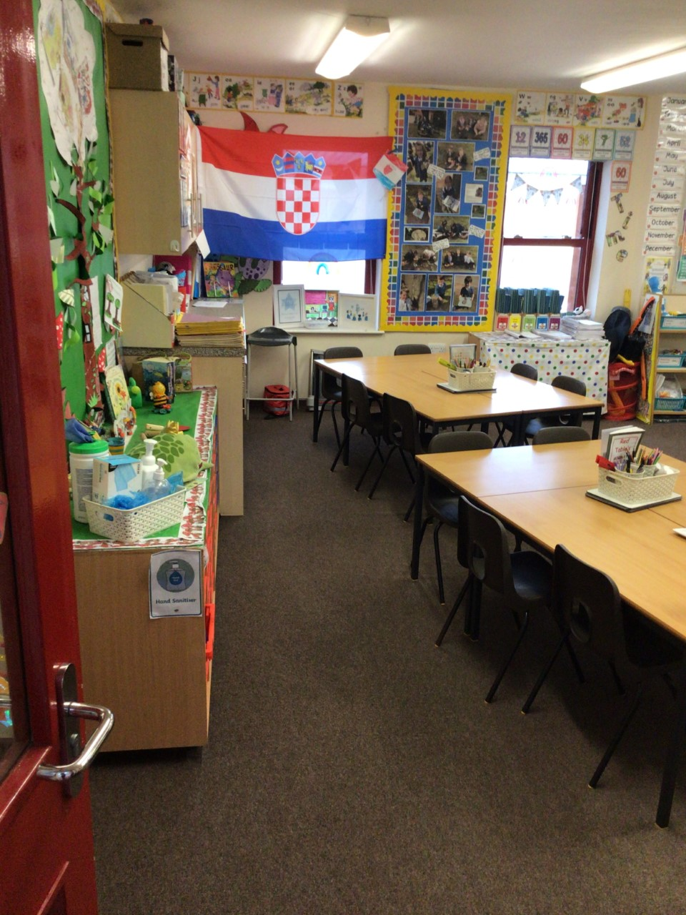
Class 4 – Mrs Adams

Slide 3
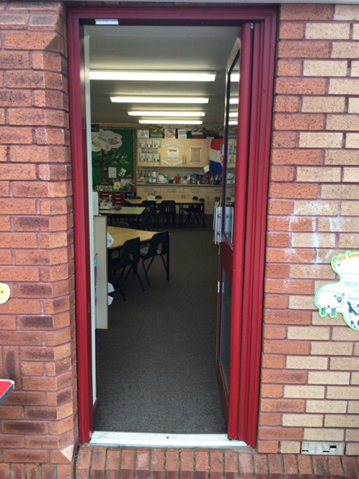
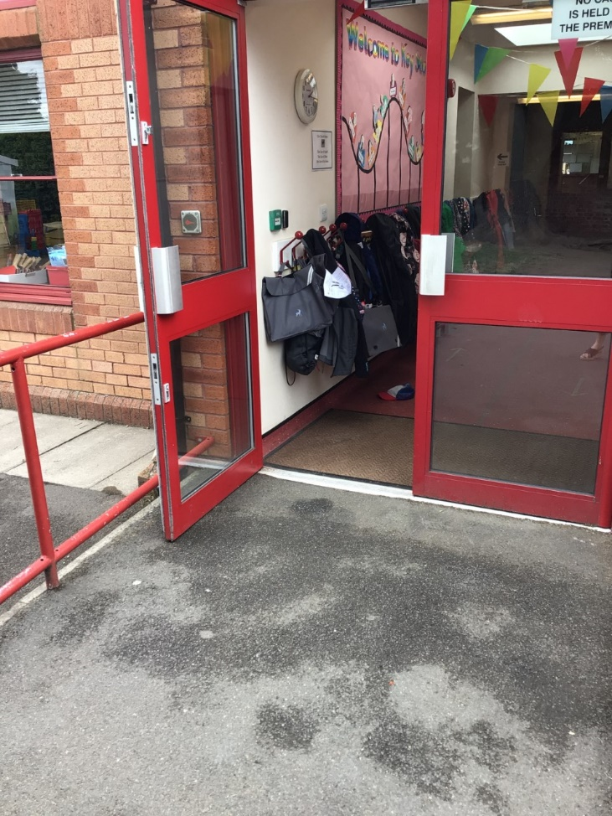
Class 4 you will come in through this door.
Doors open at 8:45am and school starts a 9:00am.
It is really important that you are on time every morning!

Slide 4
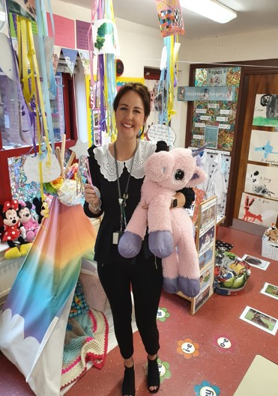
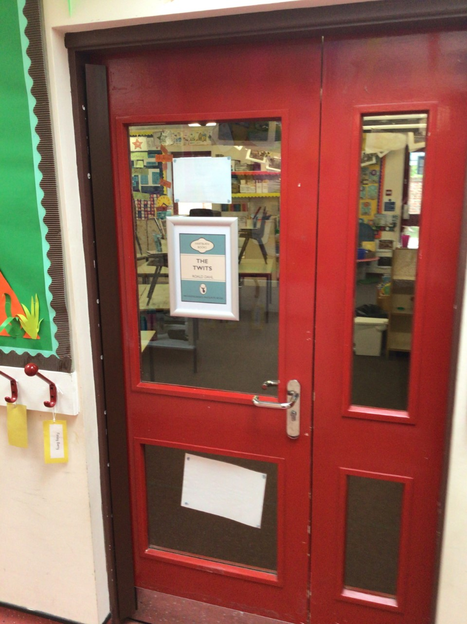
Class 5 – Miss Connett

Slide 5
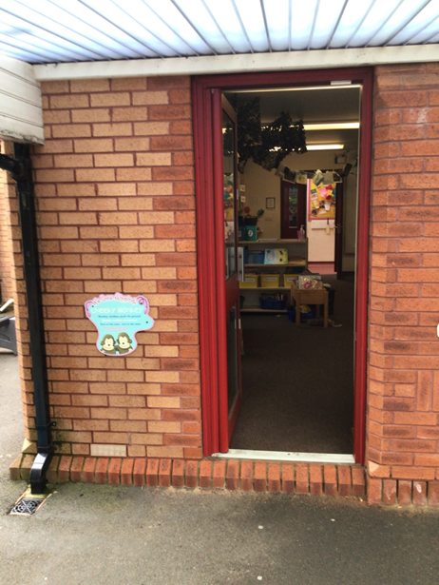
Class 5 you will come in through this door.
Doors open at 8:45am and school starts a 9:00am.
It is really important that you are on time every morning!

Slide 6
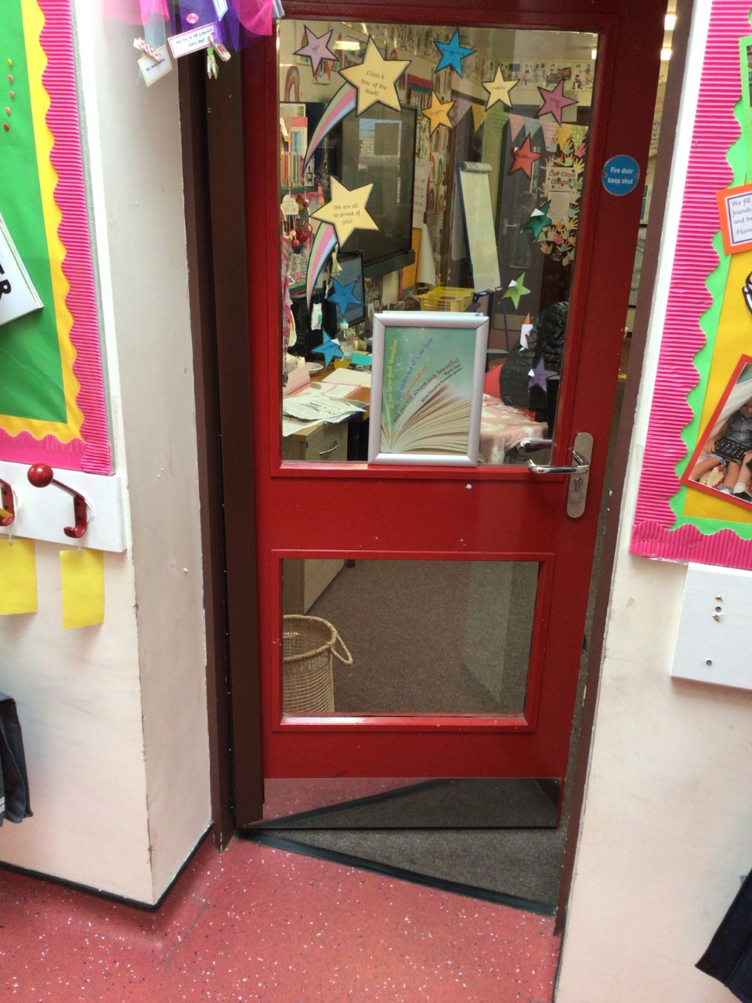
Class 6 – Mr Whitecross

Slide 7
Class 6 you will come in through this door.
Doors open at 8:45am and school starts a 9:00am.
It is really important that you are on time every morning!

Slide 8
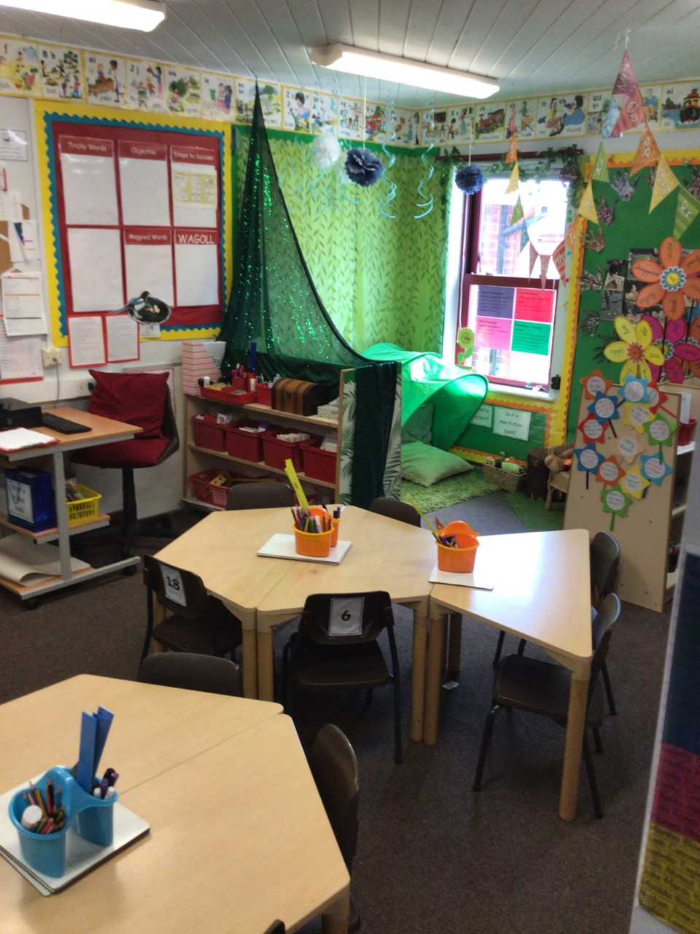
Year 1 Maths and English teacher – Miss Thompson

Slide 9
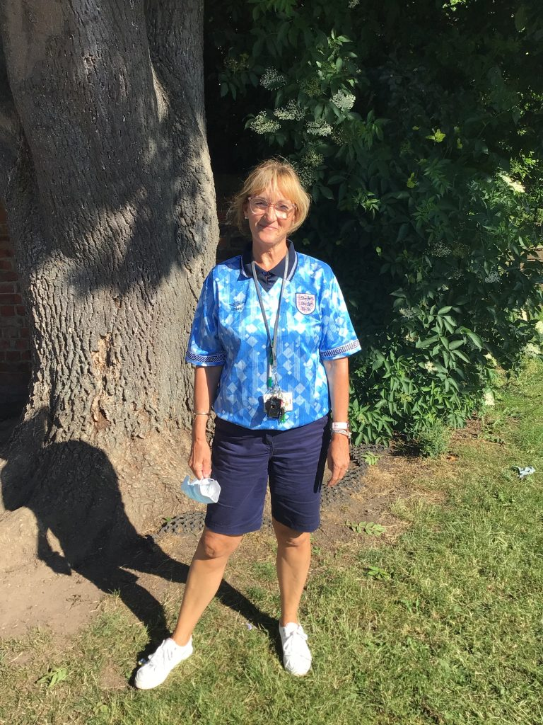
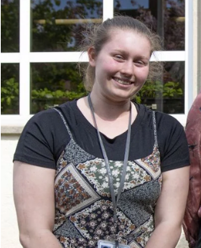
Our Terrific Teaching Assistants
Mrs George
Miss Sullock

Slide 10
Outdoor Space – you will have your playtime here.

Slide 11
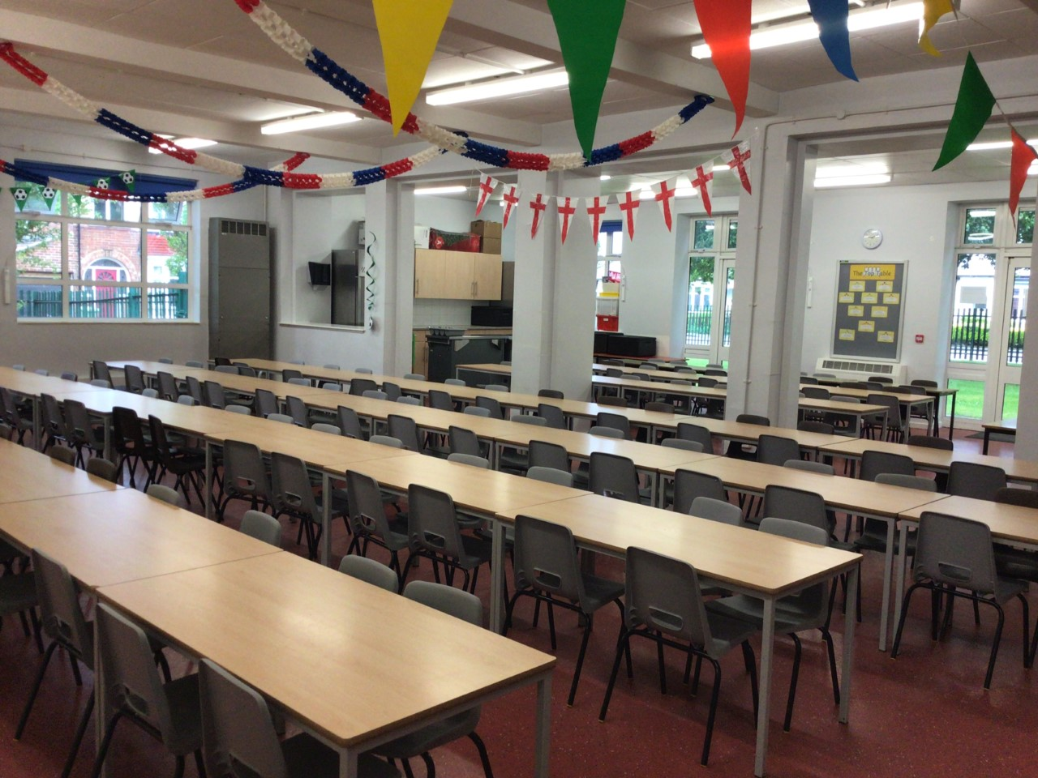
You will eat your dinner here.

Slide 13
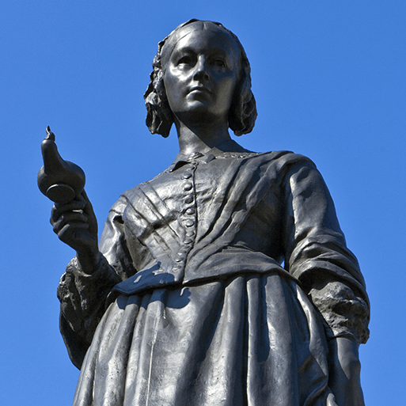
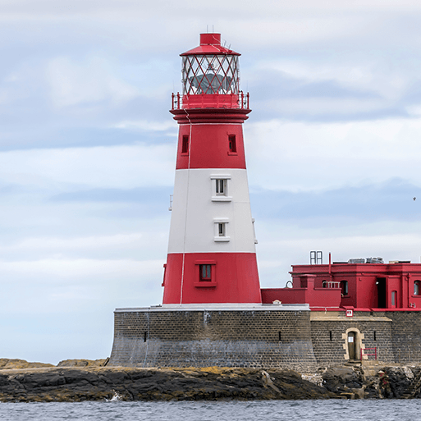
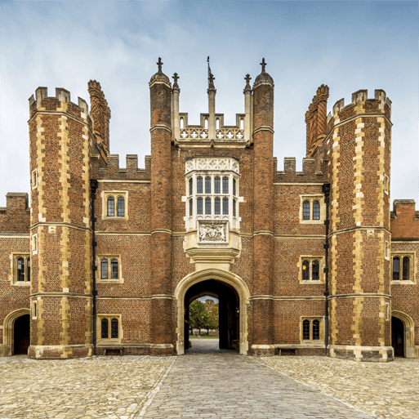
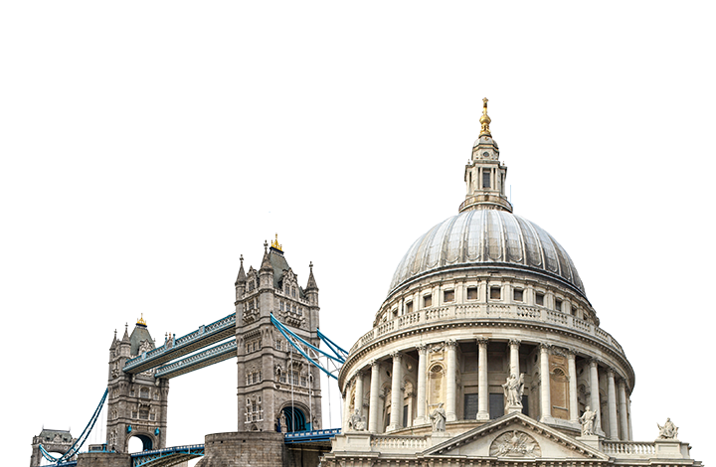
This is what you will be learning about.
Movers and Shakers
Coastline
Magnificent Monarchs
Your timetable may differ sometimes to allow for other activities.

Slide 14
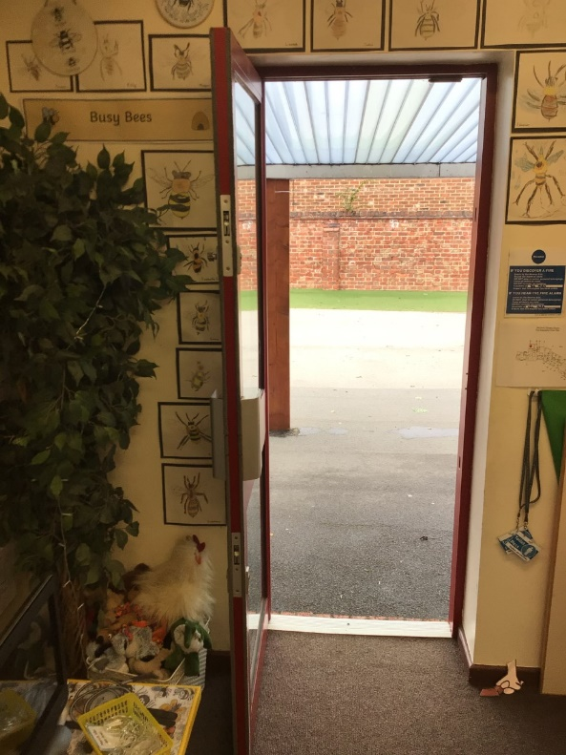
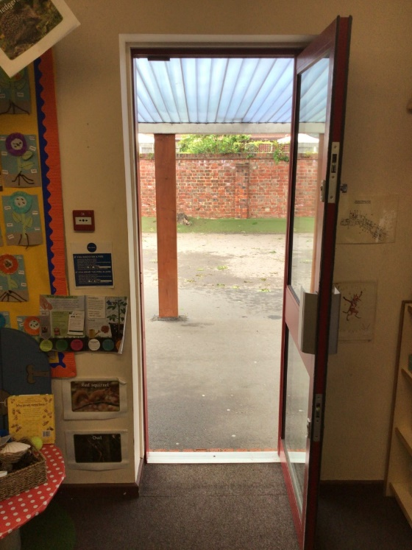
Class 4 and 5 you will leave through your classroom doors.
You will finish school at 3.15pm.
Class 4
Class 5

Slide 15
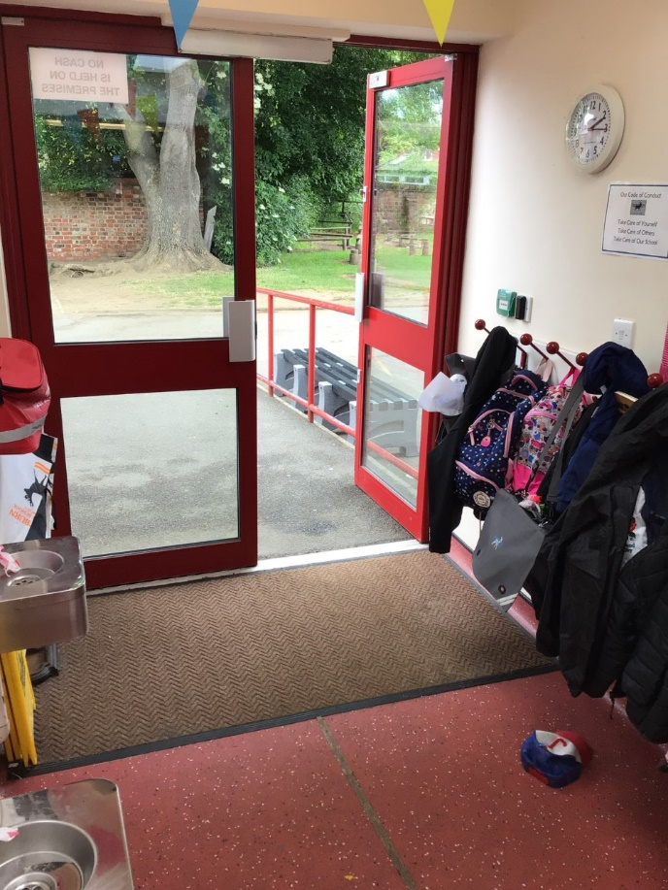
Class 6 you will leave through this door.
You will finish school at 3.15pm.

Slide 16
We cannot wait
to see you in September!
Have a lovely summer and stay safe.

