Slide 1
Welcome to
Reception

Slide 2
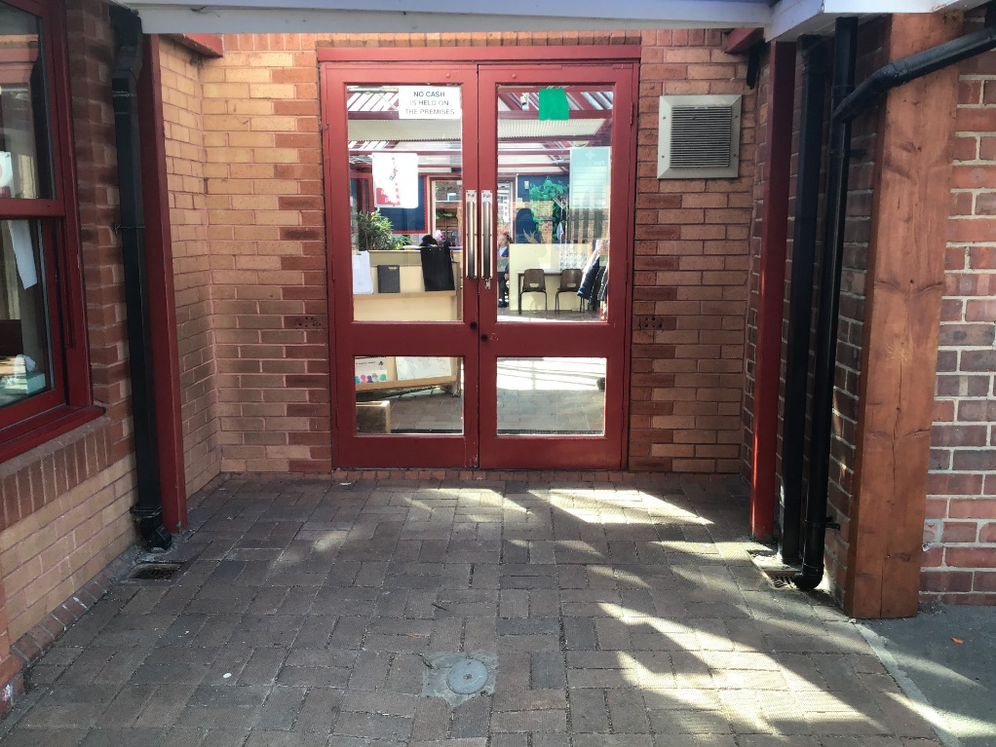
You will come in through this door.
Doors open at 8:45am and school starts a 9:00am.
It is really important that you are on time every morning!

Slide 3
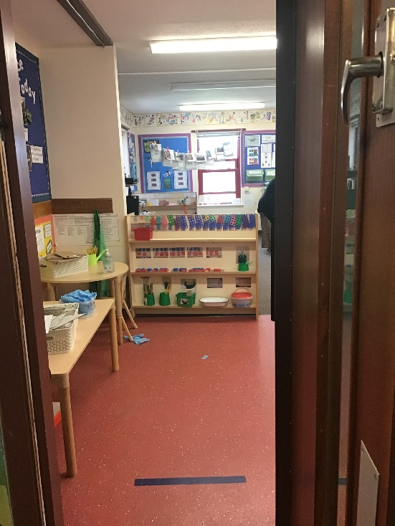
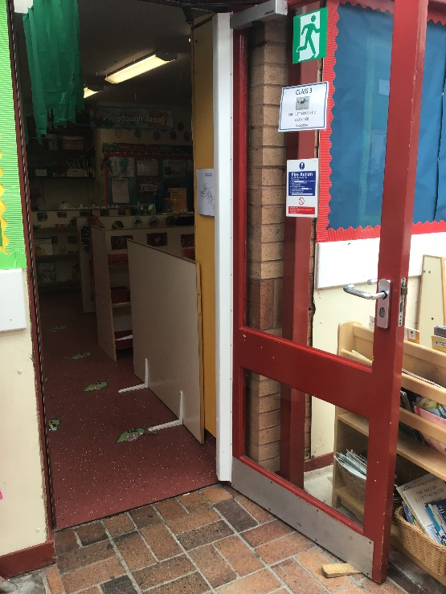
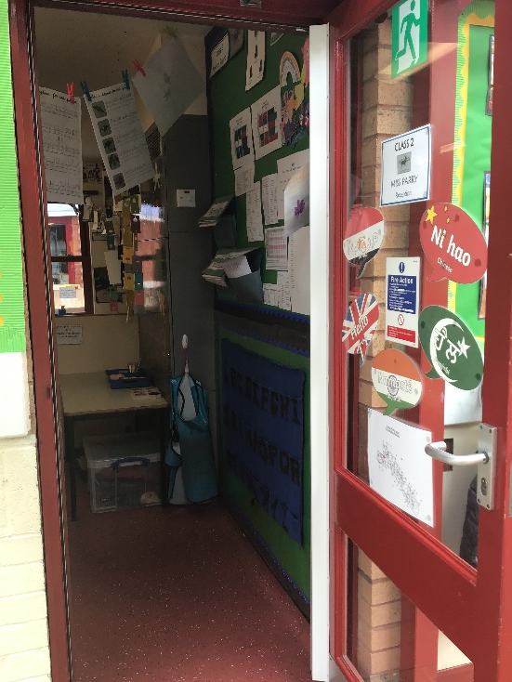
We have 3 classrooms in Reception: Class 1, Class 2 and Class 3.
1
2
3

Slide 4
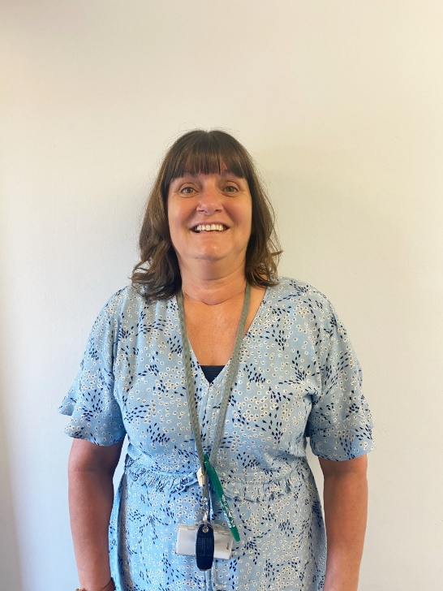
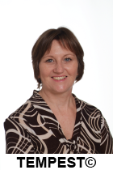
Reception TAs
Mrs McGuill
Mrs Lockwood

Slide 5
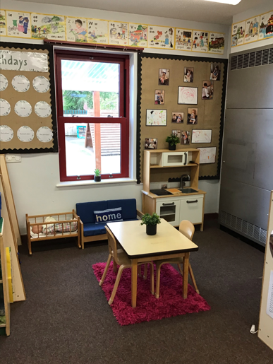
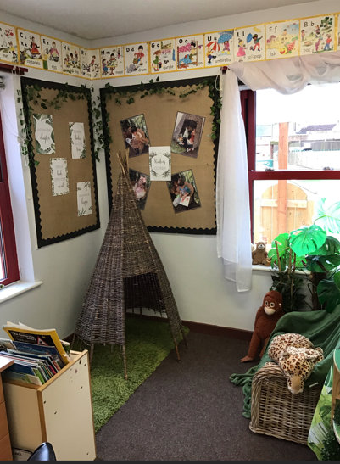
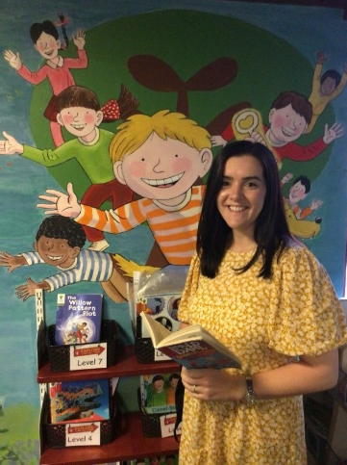
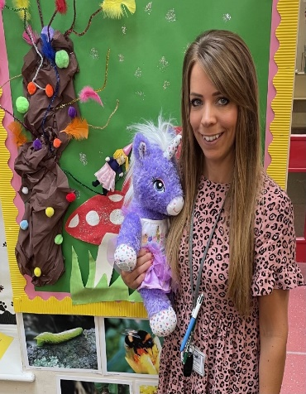
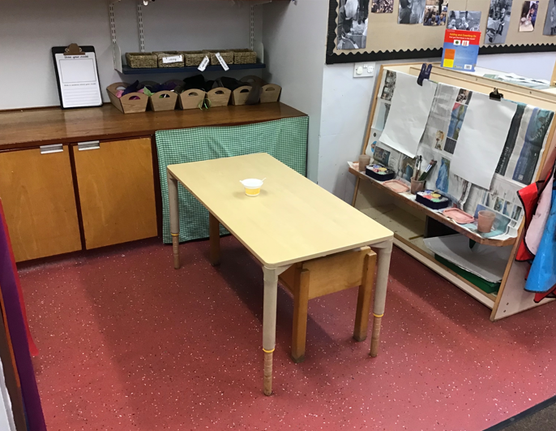
Class 1
Mrs Patel & Mrs Butterworth

Slide 6
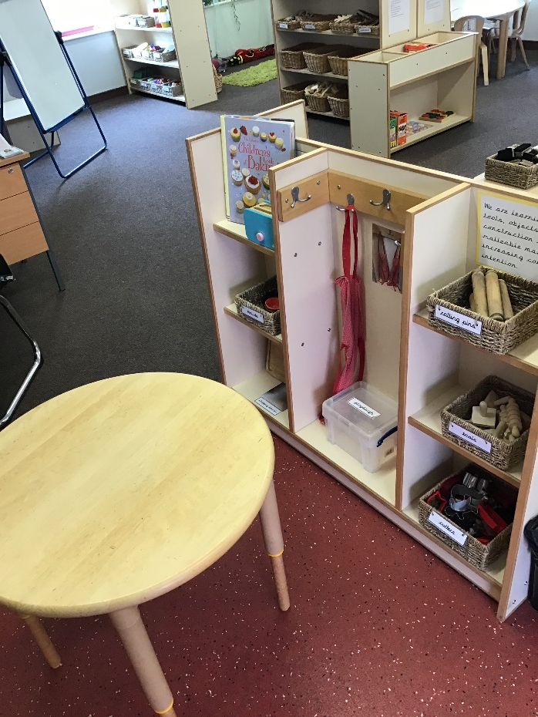
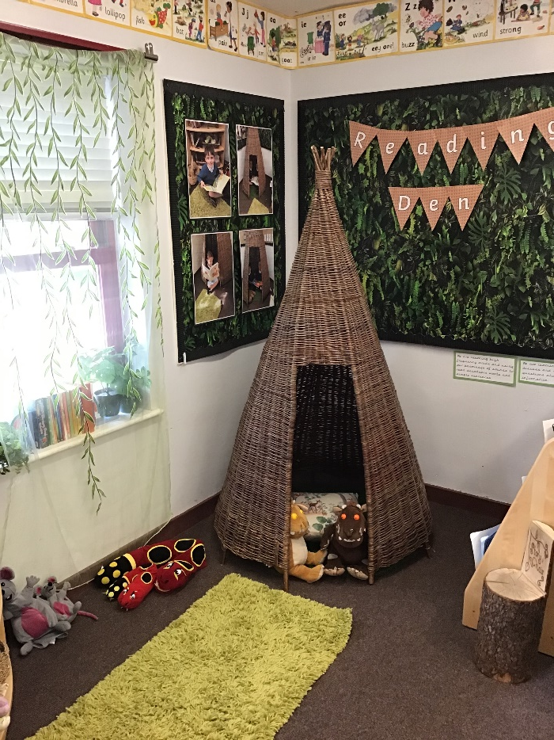
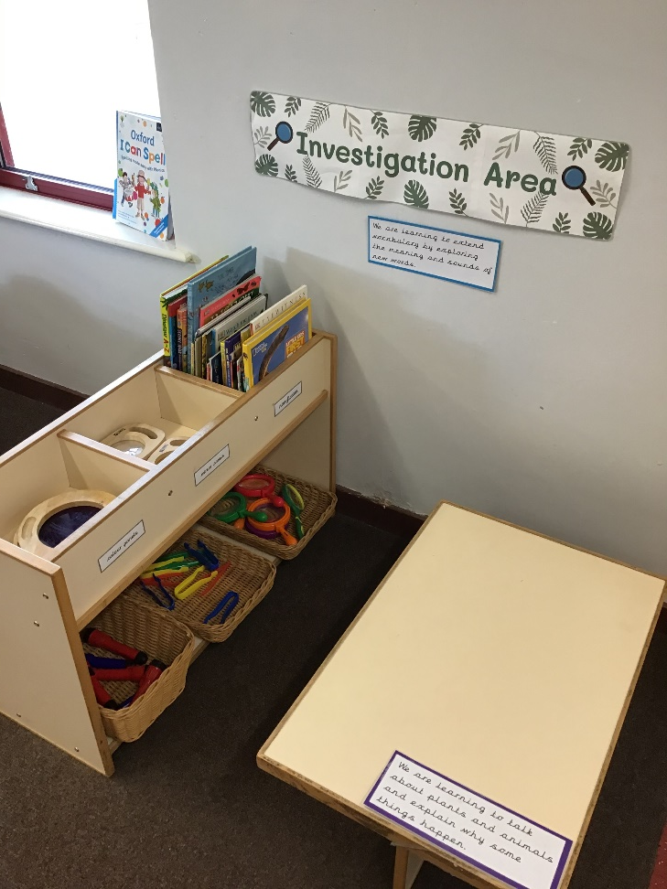
Class 2
Miss Burns

Slide 7
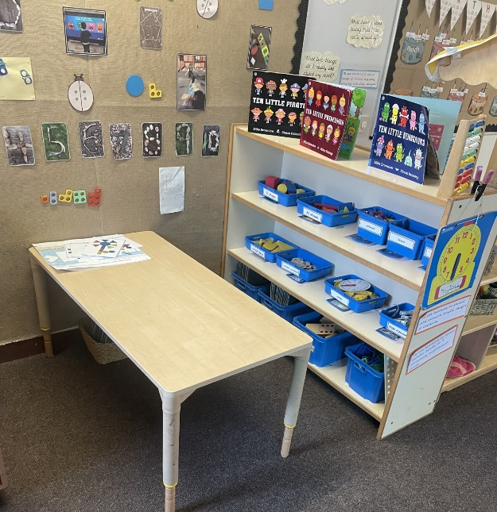
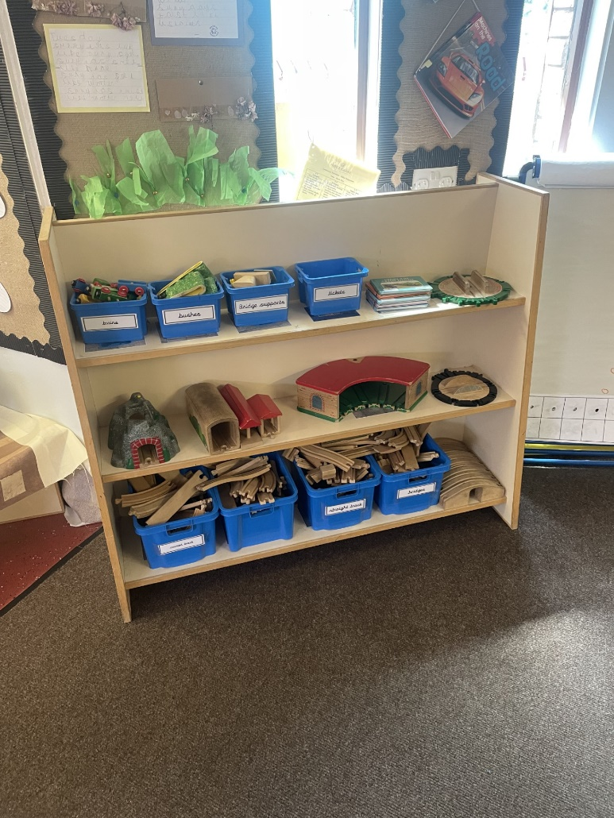
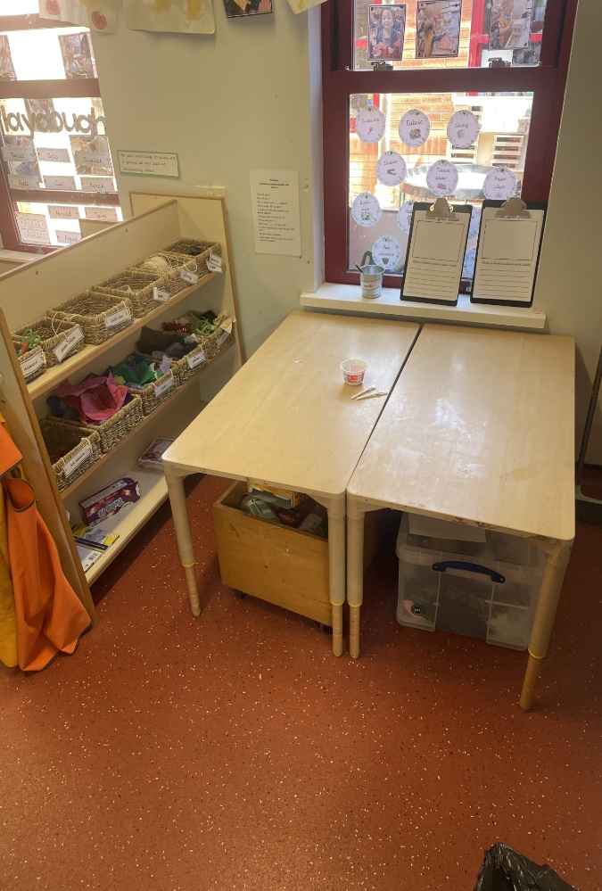
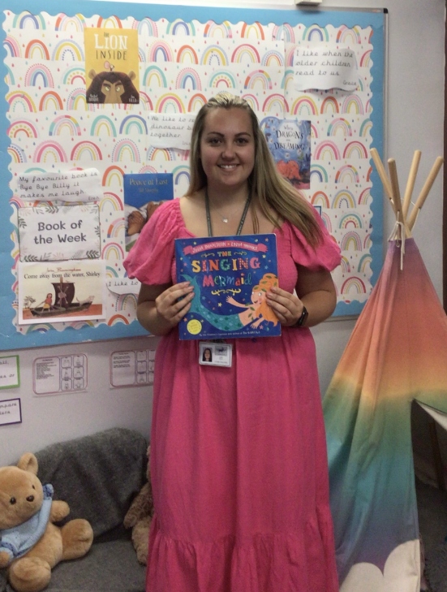
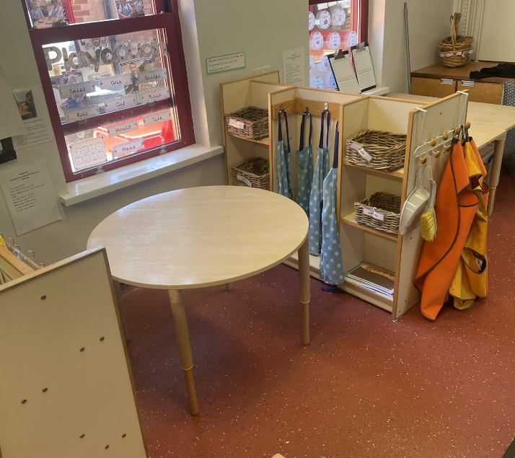
Class 3
Miss Hall

Slide 8
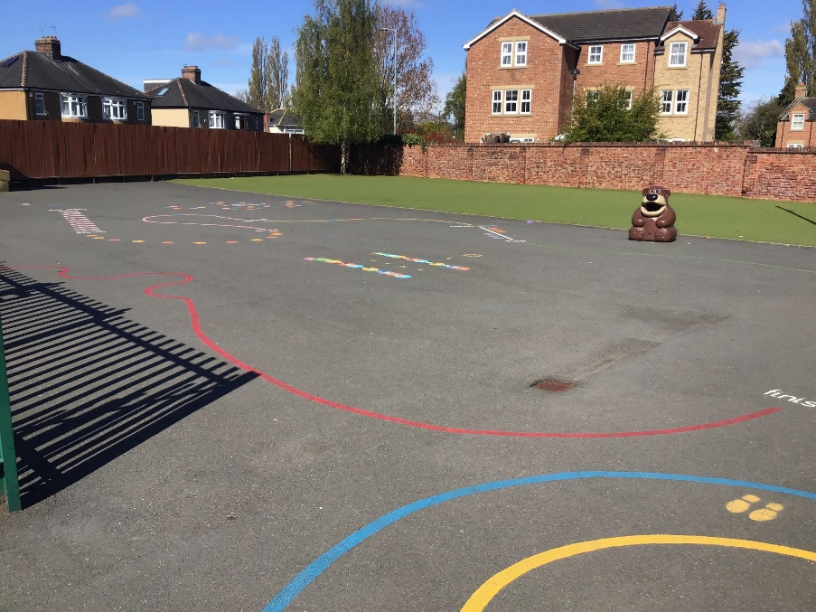
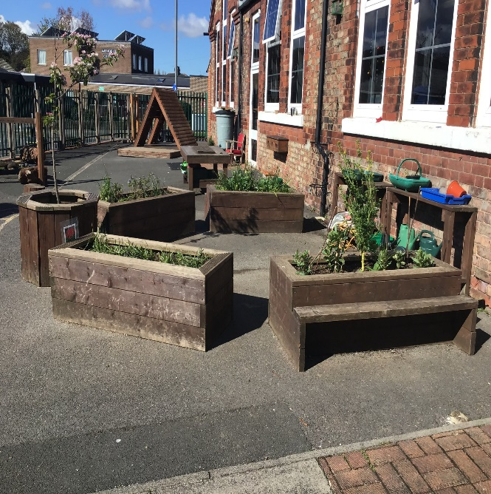
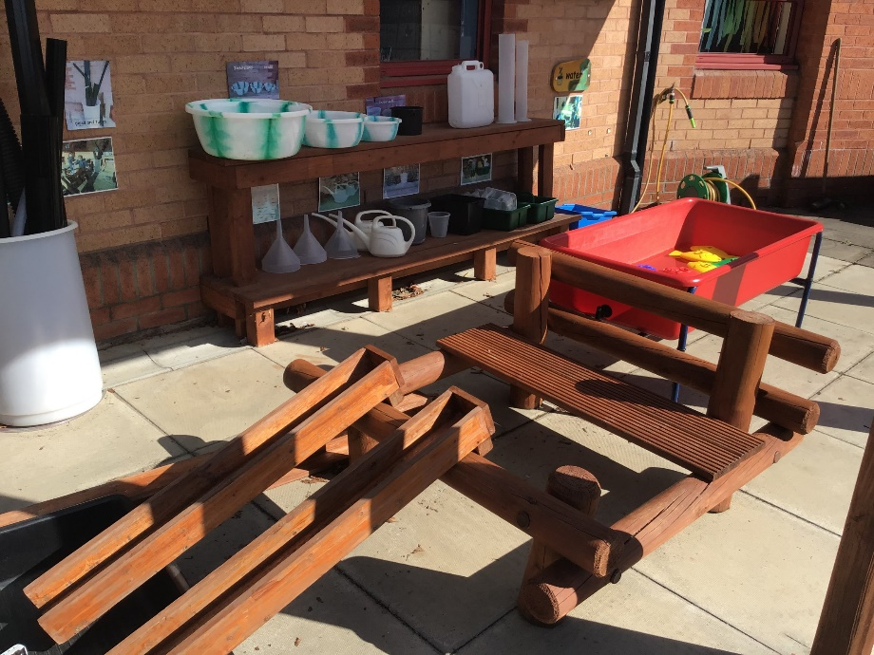
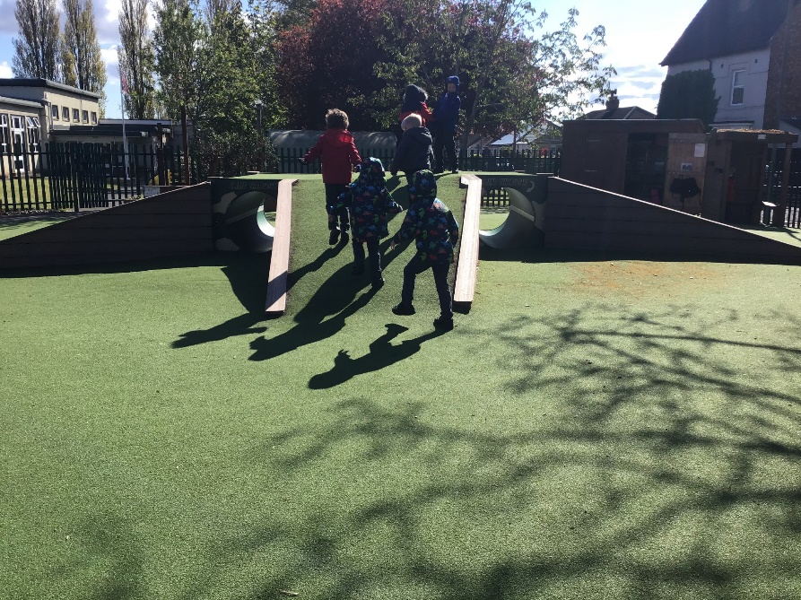
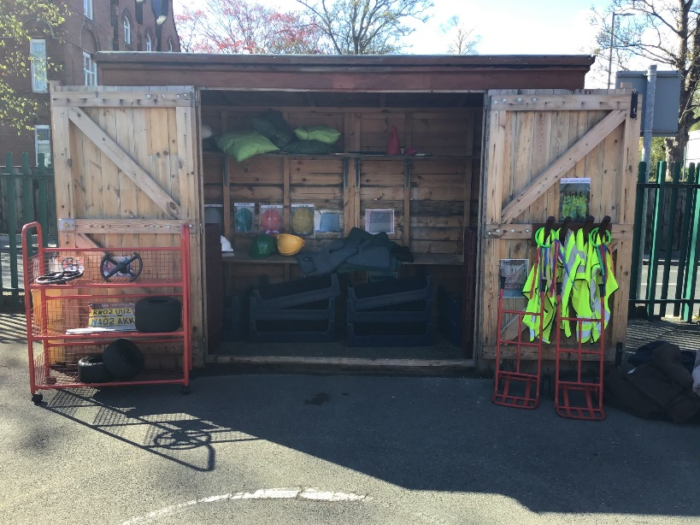
Outdoor Space.

Slide 9
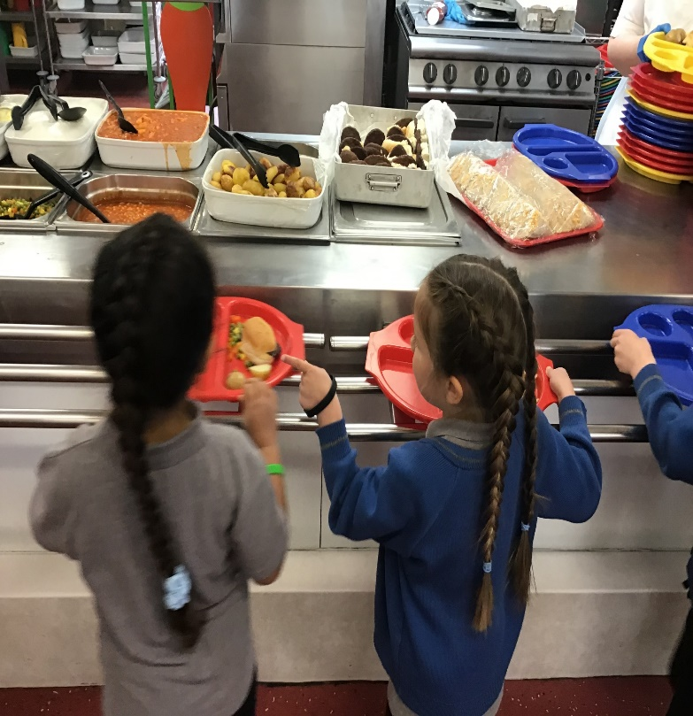
You will eat your dinner here.

Slide 10
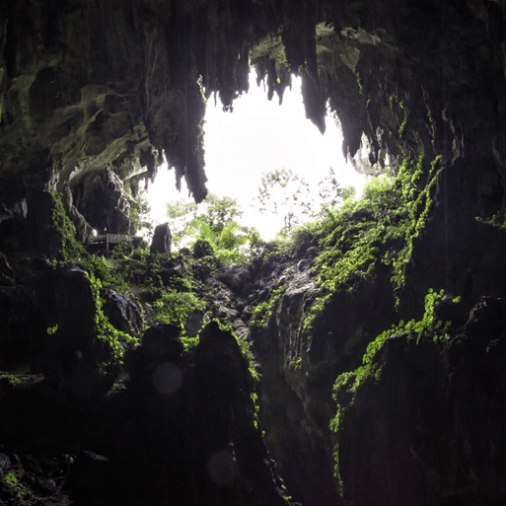
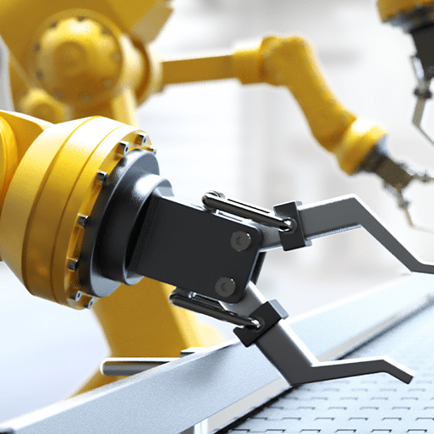
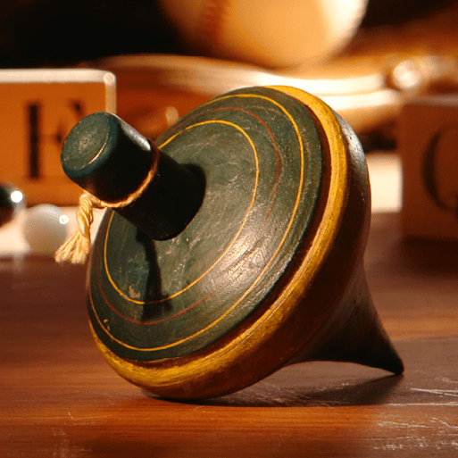
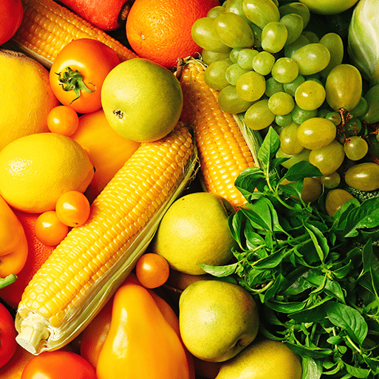
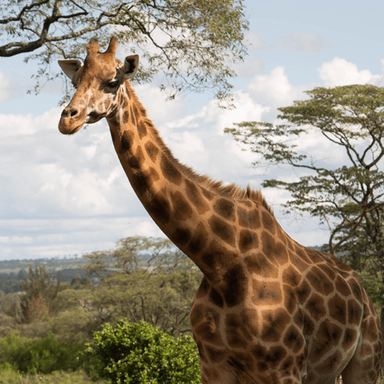
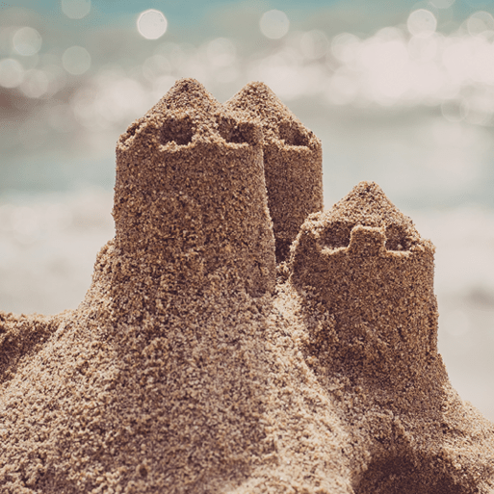
This is what you will be learning about next year
Term | ILP Topic Focus | Books
Autumn 1 | Let’s Explore | We’re Going on a Bear Hunt In Every House, on Every Street Mr Gumpy’s Outing
Autumn 2 | Marvellous Machines | The Most Magnificent Thing Car, Car, Truck, Jeep No-Bot, the Robot with No Bottom!
Spring 1 | Long Ago | Rosie’s Hat Coming to England Old Bear
Spring 2 | Ready, Steady, Grow | Jack and the Beanstalk Handa’s Surprise Rosie’s Walk
Summer 1 | Animal Safari | A First Book of Animals Little Red and the very Hungry Lion Hello, Hello
Summer 2 | On the Beach | Who’ Hiding at the Seaside? Somebody Swallowed Stanley Come Away From the Water, Shirley
Every day, children will have opportunities to work and play using a wide range of resources, equipment and materials to develop skills, confidence and independence.

Slide 11
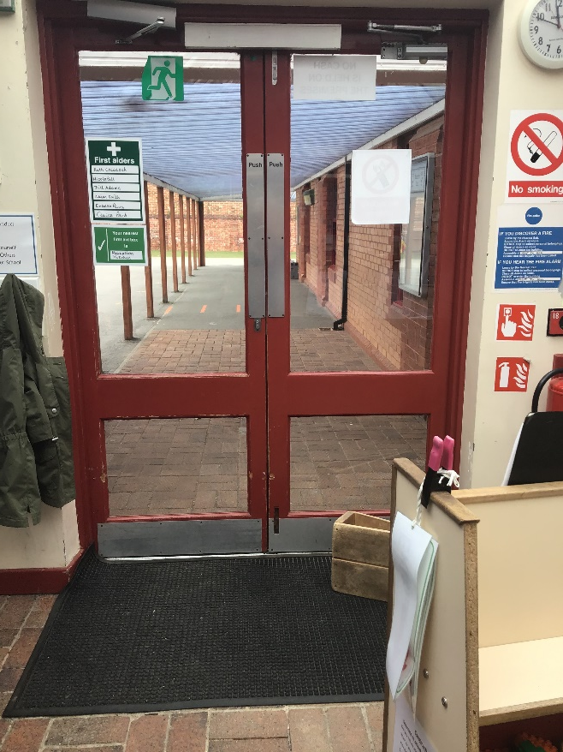
You will leave through this door.
You will finish school at 3:15.

Slide 12
We cannot wait
to see you in September!
Have a lovely summer and stay safe.

