Slide 1
Welcome to
Year 4

Slide 2
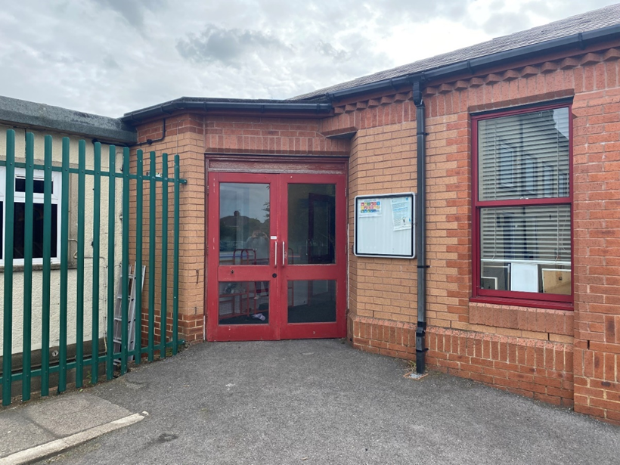
You will come in through this door.
Doors open at 8:45am and school starts a 9:00am.
It is really important that you are on time every morning!

Slide 3
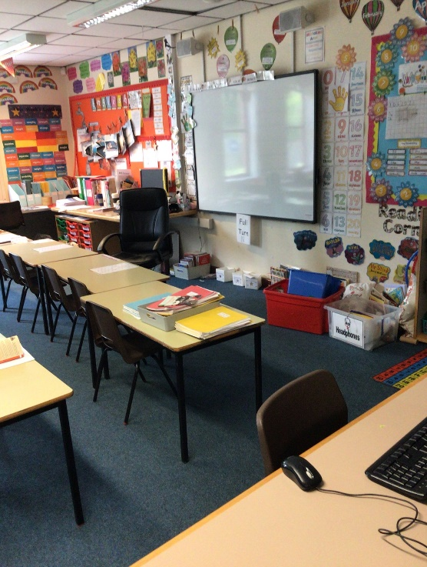
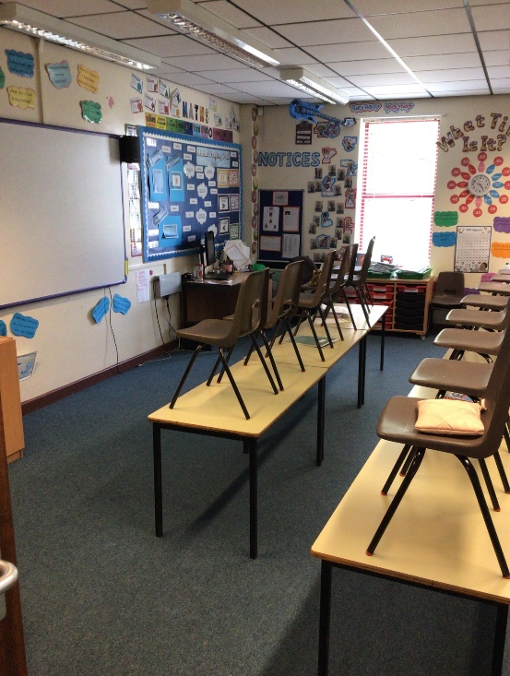
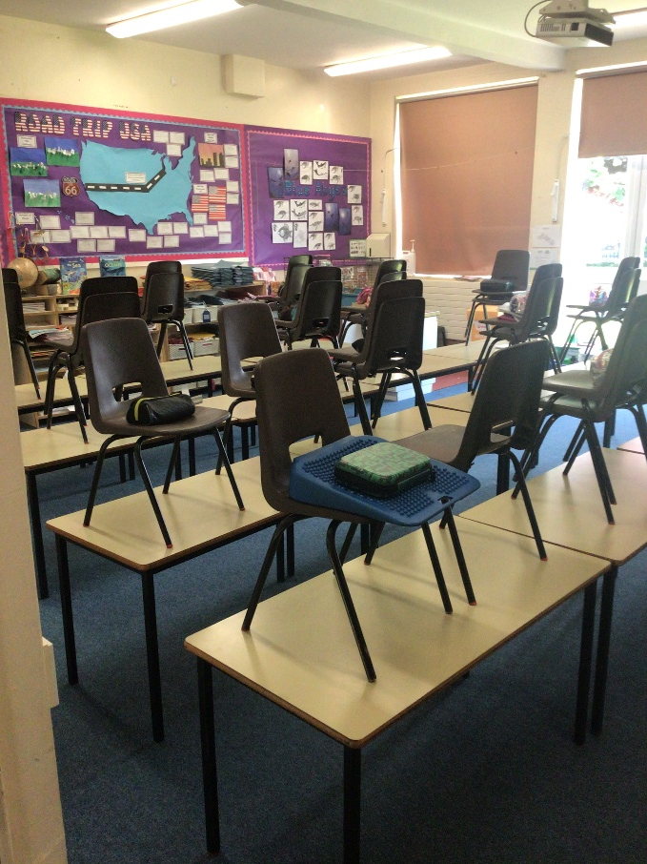
We have 3 classrooms in Year 4: 11, 12 and 13.
Class 11
Class 12
Class 13

Slide 4
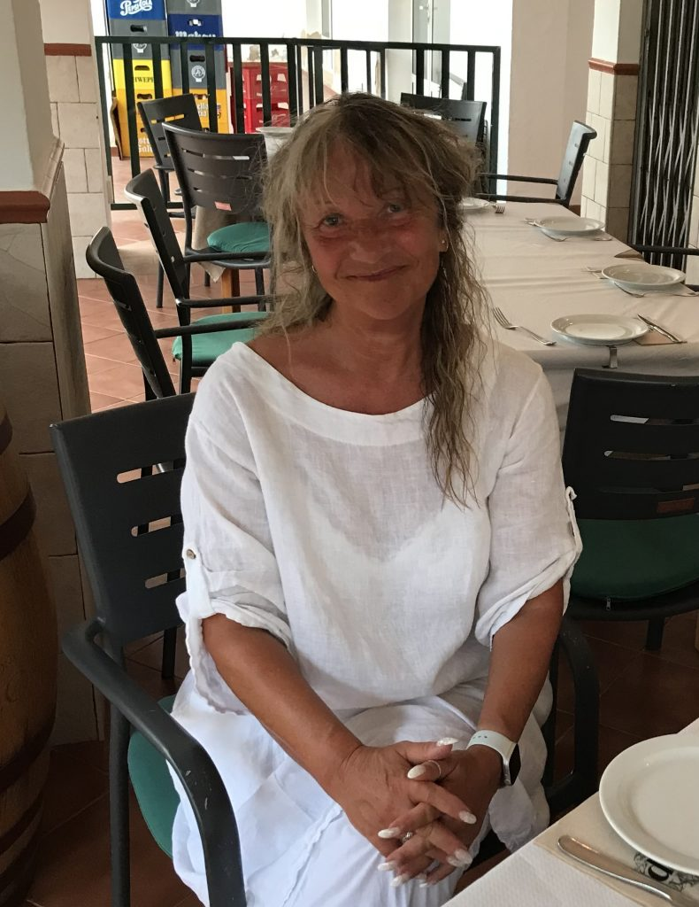
Class 11
Mrs Hughff

Slide 5
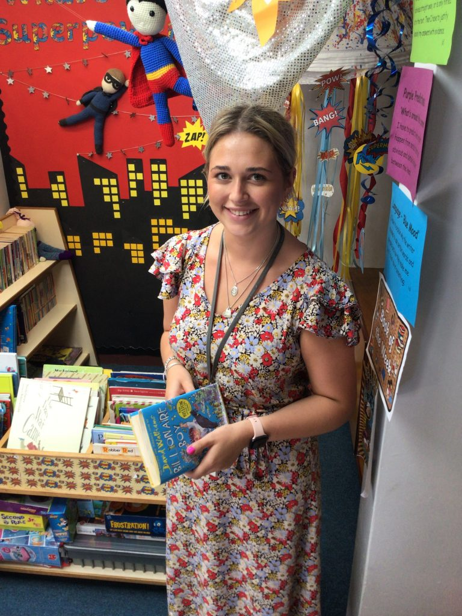
Class 12
Miss Knox

Slide 6
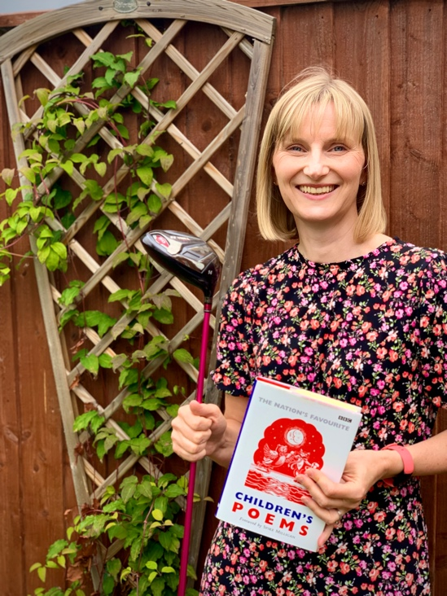
Class 13
Mrs Magowan
Mrs Willox

Slide 7
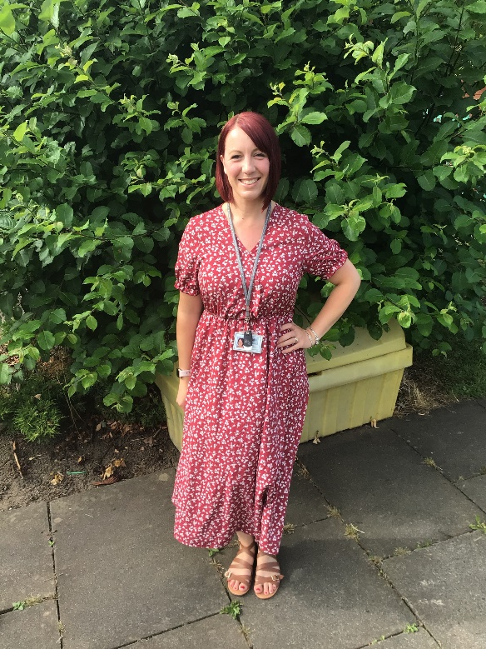
Mrs Thurlwell
Our Terrific Teaching Assistant

Slide 8
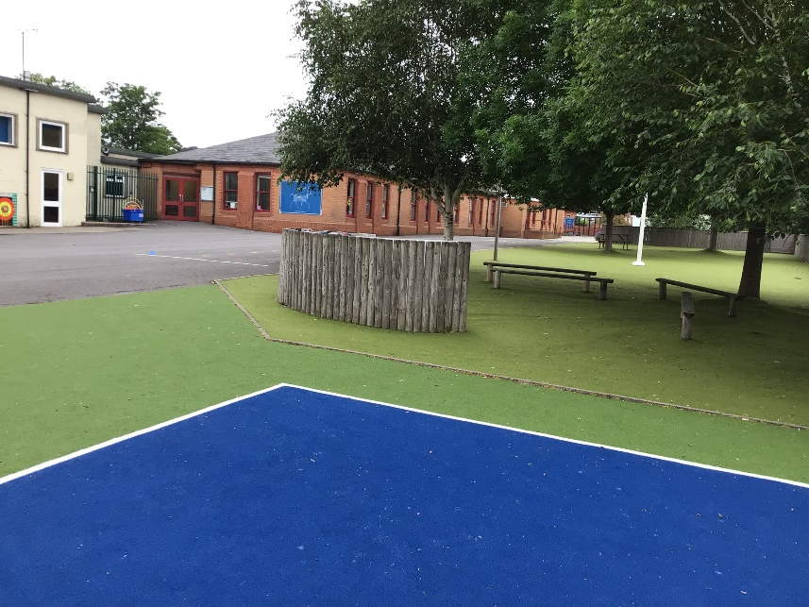
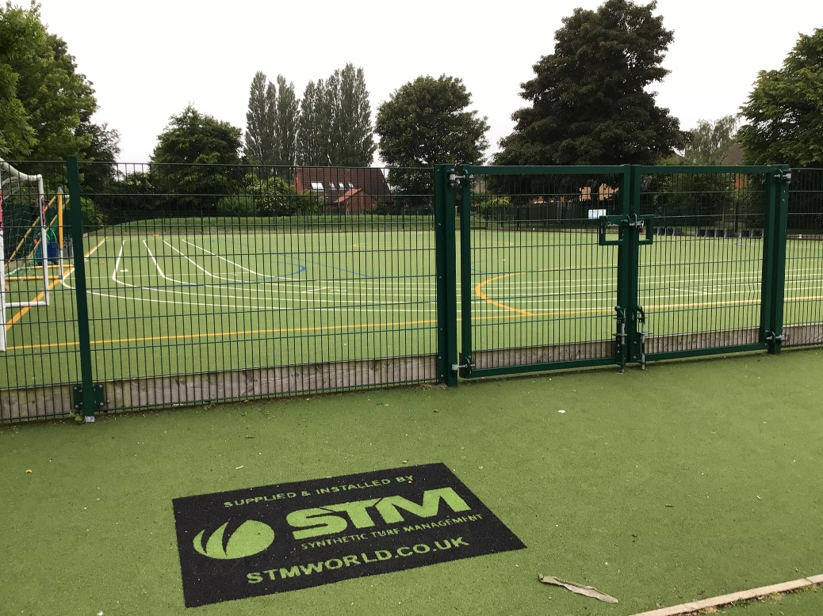
Outdoor Space.

Slide 9
You will eat your dinner here.

Slide 10
This is what your day will look like.
9:00 – Registration
9:05 – Reading
9:30 - English
10:45 – Break
11:00 – Maths
12:15 Lunch
13:15 – Afternoon lesson
14:30 – Afternoon lesson
15:15 - Home
Your timetable may differ sometimes to allow for other activities.

Slide 11
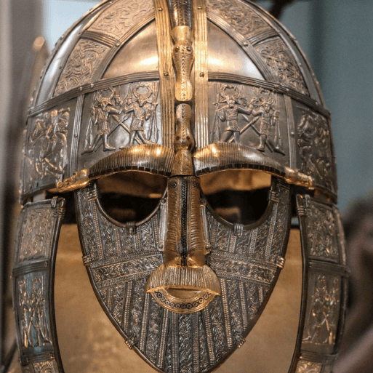
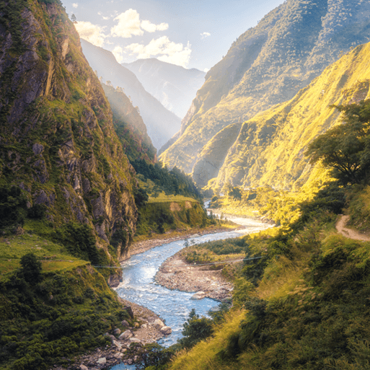
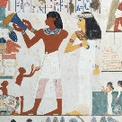
This is what you will be learning about.
Invasion
Misty Mountain, Winding River
Ancient Civilisations

Slide 12
You will leave through this door.
You will finish school at 3:15.

Slide 13
We cannot wait
to see you in September!
Have a lovely summer and stay safe.

